Slide 1
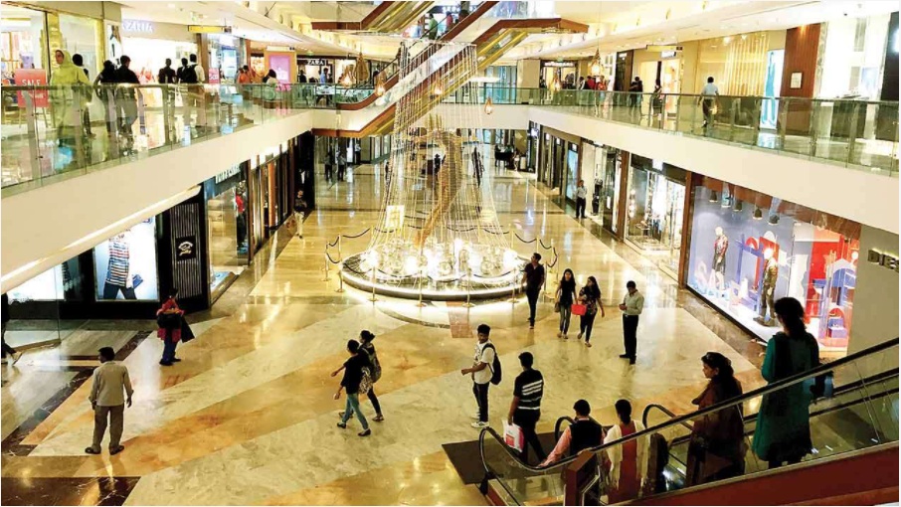
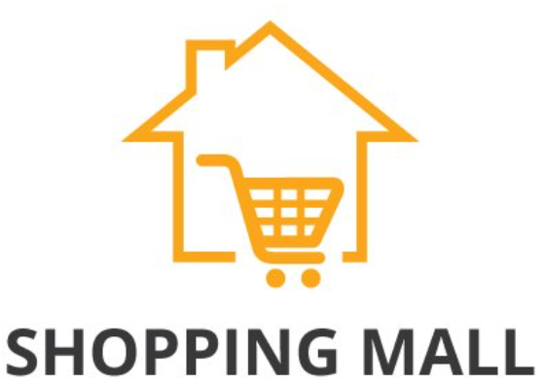
Mall Customers Analysis
March 2022

Slide 2
Problem Statement
Malls and shopping centres are always in a race to get the most out of customers and make maximum revenue on a yearly basis. The purchasing power of a customer is on a constant rise although customers are always on the lookout for new offers and ease of purchasing.
To understand which customers are likely to convert [Target Customers]. This information will be shared with the marketing team and will help them plan the strategy. This would also help them retain the existing customers in the business as well increase the overall net profit of the business and reduce turnover by devising some customer retention strategies and loyalty programs.
The dataset is of Mall customers at a customer id level and consists of some demographic information i.e. annual income, age etc.

Slide 3
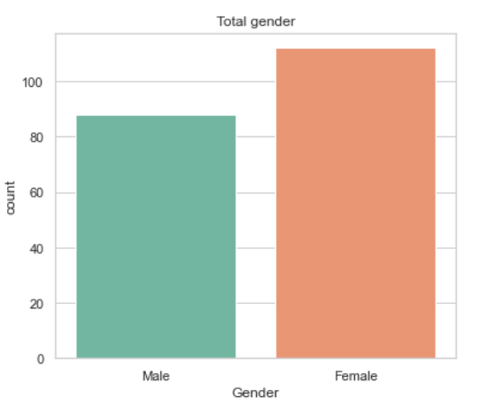
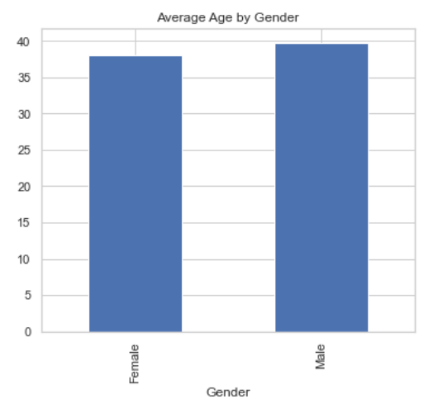
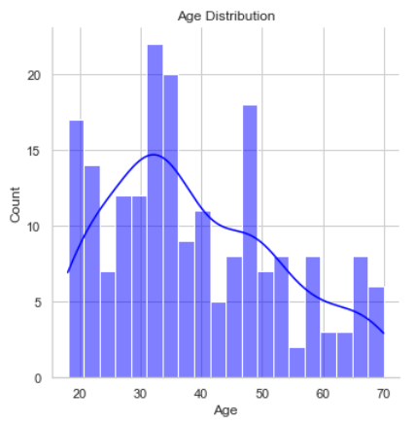
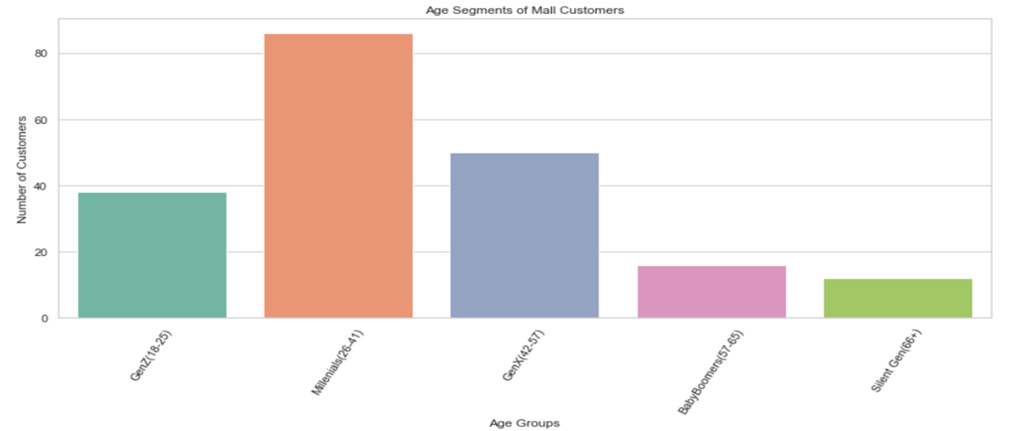
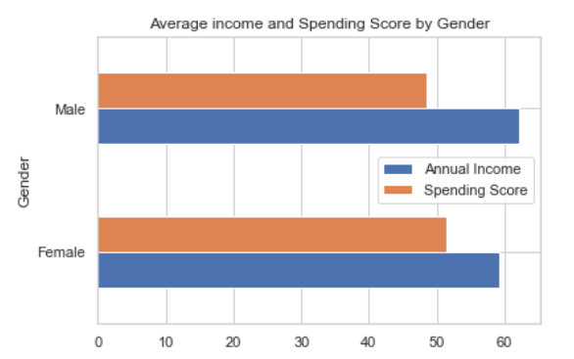
Age Distribution of Mall Customers: We can see that Female customers are more compare to Male customers and they fall into the average age of ~37(Female) and ~39(Male) in the Millennials segment. Also the spending score of the Female customers is higher as compare to the Male and the Annual Income is higher of the Males compare to that of the females.

Slide 4
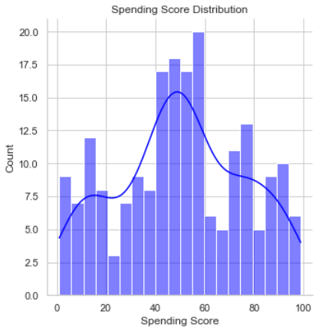
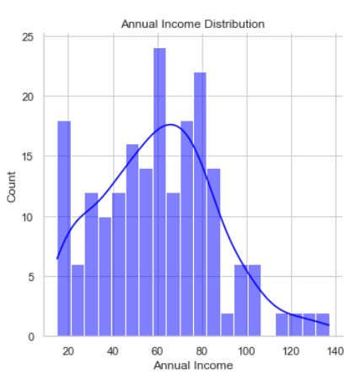
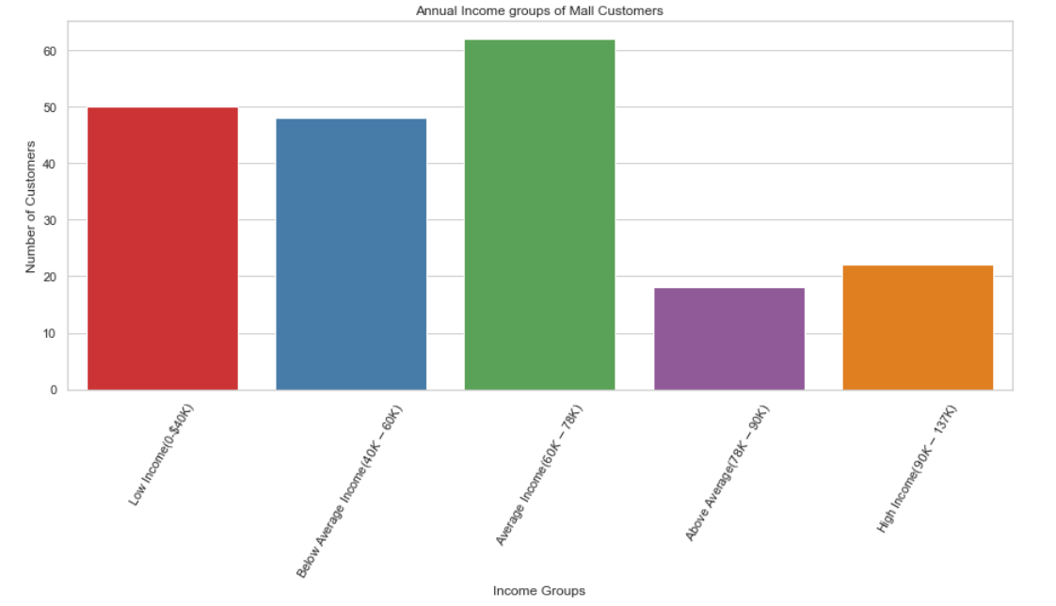
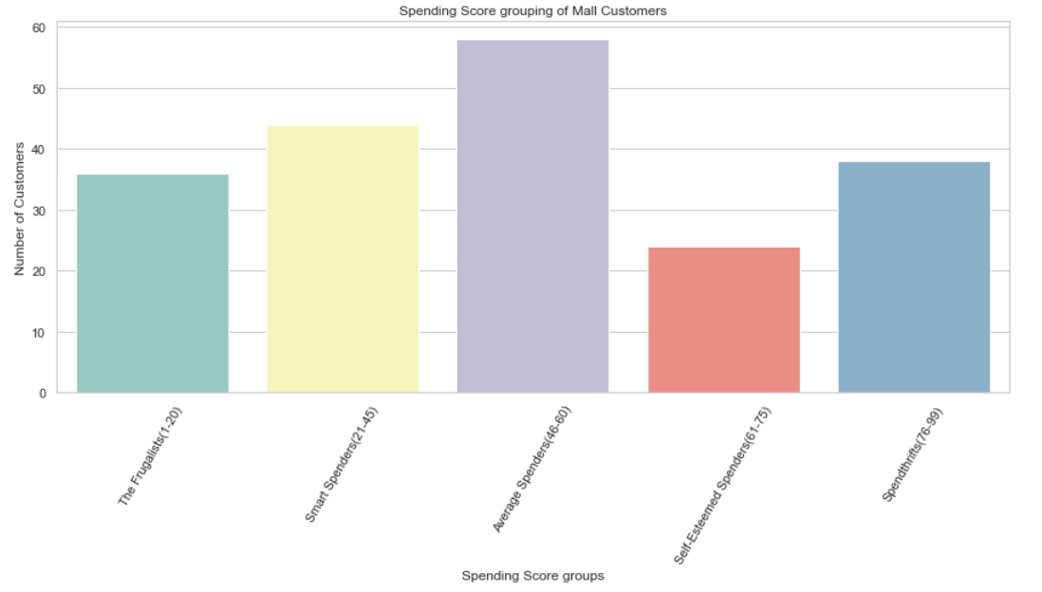
Spending Score and Annual Income of Mall Customers: Spending Score is mostly distributed around 45-60(Average Spenders) and the Annual Income of the customers is distributed between 60-80(k$) (Average Income group). The Smart Spenders and the spendthrifts are the following segments of customers with most customer volume

Slide 5
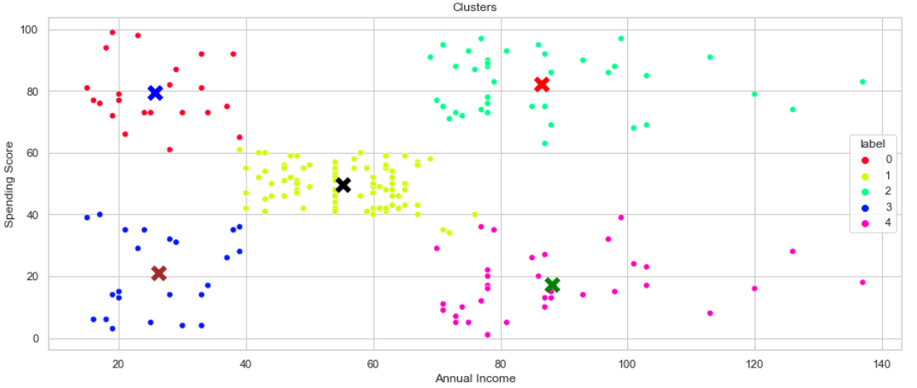
Customer Segmentation of Mall Customers
Clusters | Segment Categories
0 | Low Income – High Spenders
1 | Average Income – Average Spenders
2 | High Income – High Spenders
3 | Low Income – Low Spenders
4 | High Income – Low Spenders
High Engagement
Medium Potential
High Potential
Low Potential
Low Engagement

Slide 6
Customer Segmentation of Mall Customers by Age and Gender: Millennials constitute the largest volume of the customers and also have the highest value customers, followed by Gen X. Females are mostly the average spenders and the average income customers
Clusters | Segment Categories | Cluster Colours/ Customer Counts | % of Total
0 | Low Income – High Spenders | 22 | 11%
1 | Average Income – Average Spenders | 81 | 40.5%
2 | High Income – High Spenders | 39 | 19.5%
3 | Low Income – Low Spenders | 23 | 11.5%
4 | High Income – Low Spenders | 35 | 17.5%

Slide 7
Recommendations
Target Customers(Cluster 2)- High Income and High Spenders are the high value customers(VIPs) for the business. Target these customers by giving premium mall loyalty memberships coupons/rewards(i.e. giving a membership that would give them a 20% off on a purchase value of above a certain amount and on the next subsequent purchase in the same week 30% on any other product ) to maintain the retention metrics for these set of customers. More customer engagement strategies are require to understand the changing consumer preferences.80% of business comes from 20% customers(here 19.5% of total).
Cluster 4: Target the group of high income and low spenders as these are the customers that have highest potential to grow the business. They are value customers. So, the group should be given promos code/discount offs and their overall shopping experience should be improved. Drive these customers to opt in to marketing emails/sms or social media campaigns.
Cluster 1: Average Income and average spending are the largest and the main group of customers. Keep a track of their shopping performance and retention. Drive these customers through location based marketing by gathering purchase information and giving them offs on movie tickets, food coupons etc. to better engage these customers.
Cluster 0: Low Income and High Spending Customers are customers that have low potential as these are the happy customers and are promo hunters. But the customer volume is low. To better target these customers a recommendation system strategy to recommend the customers based on the maximum offers on select products are displayed to these customers which would help increase these customers spending volume sharing preferential information.
Cluster 3: Low Income and Low spenders are the smallest in size and add less value to the company. Although they do have the potential to move the low income and high spenders category if given on the spot offers to increase their overall basket volume. Make least marketing investment on this group.
Better understanding of the data could be made if transactional level data is available. Best Segment is 2 which are most likely to enrol/convert to loyalty programs.

